Slide 1
典型用户和场景
邹欣
2018
构建之法 – 现代软件工程 第 10 章

Slide 2
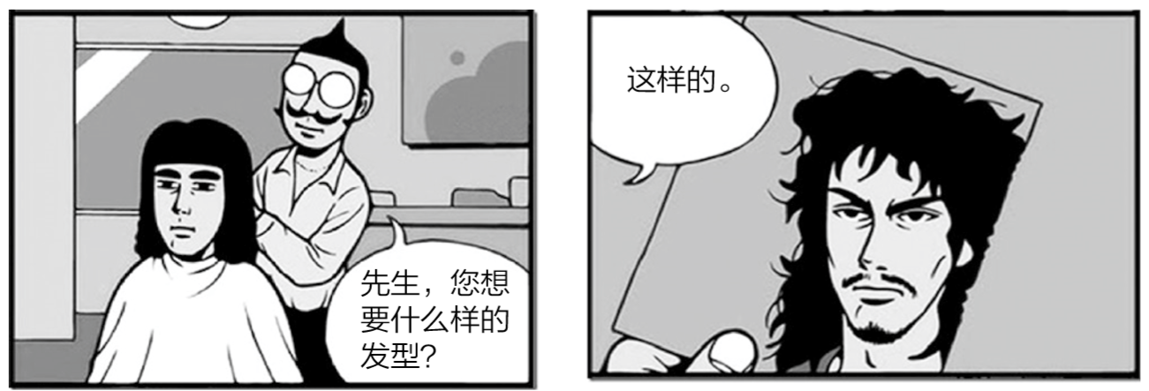

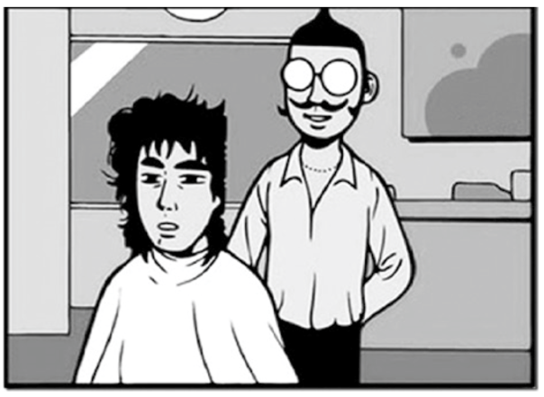
需求 – 都按照用户的要求来？
我把用户需求 100% 都实现了，不就行了么？

Slide 3
Scenario != sum(functions)
茶壶的功能
茶壶盖
茶壶体
茶壶把
茶壶嘴
各个功能还要有机结合起来，满足用户的需求
下面的茶壶满足了用户的需求了么？

Slide 4
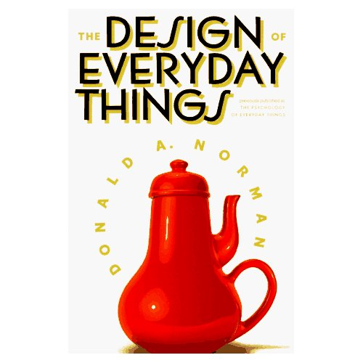

Slide 5
Scenario ！= demo
Story of coke vs. Pepsi
First Taste vs. long term taste
Scenario means
Experience in first 3 minutes
Long term experience

Slide 6
Example 4
“Minority Report”

Slide 7
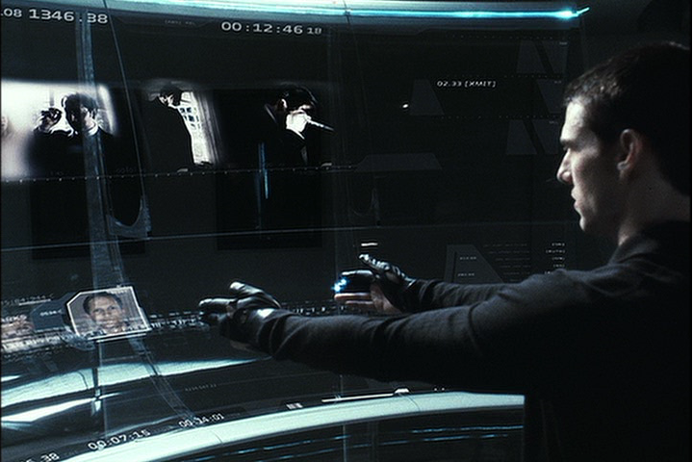

Slide 8
Working like that for 8 hours?
It’s cool on demo, but your arms will become very tired when using it for a long time.
According to Andy Van Dam, the movie crew hung Tom Cruise’s arms after he become so tired after a while

Slide 9
Example 5
A foreign student needs to set up online banking in China
Go to bank web site, change language to English
Finish the require steps
Bank sends a password to user’s cell phone via SMS
Problem
The SMS is in Chinese Text, not English
the foreign student’s cell phone can’t display, he can’t read it either!

Slide 10
Features have to work together, seamlessly
You work on a reader app, it has a dictionary, you have 2 features:
Download the dictionary
When click a word, show the dictionary entry, if no dictionary is present,
A) throw out an exception
B) a dlg to promote user to download
C) secretly download
D) cancelable download
Notes:
What if you don’t want to download, or your network is disconnected?

Slide 11
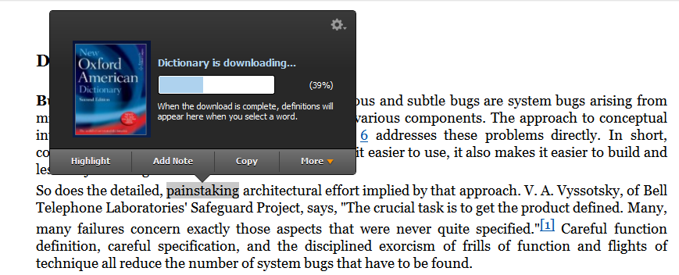
Kindle for PC
Notes:
第一次下载 Kindle for PC 的时候并没有下载词典；当用户第一次触发词典这个功能的时候，才提示用户，并开始下载。

Slide 12
Persona & Scenario
Persona interact with software
Persona has a “need”
Persona uses the software to solve the “need”, in multiple steps.
Persona’s need is solved, he/she is happy

Slide 13
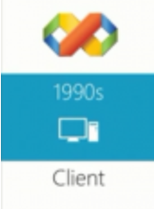
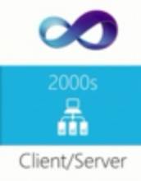
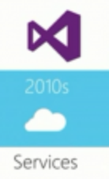
Persona – used in Visual Studio
Challenges for Visual Studio Team
there are millions of customers, using the software in different ways, for different purpose…
VB, C#, C++, MFC, asp.net, J#, TFS, .Net Framework
Hobbyist, students, professionals,
Server, PC, embedded, web,
Team size – 1..1000
Different culture and country
how to design the next version to satisfy most of them?
How to make sure the target customers get the benefit from end-to-end?
There are 500 developers working in VS team, how do we convince all of them agree on serving the same group of customers?

Slide 14
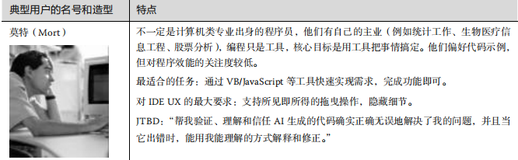
典型用户 – Visual Studio
用到一些编程的技术人员，但不是专业编程的。

Slide 15
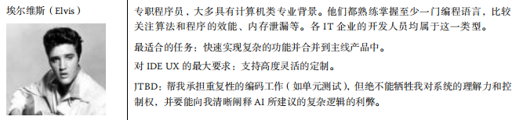
典型用户 – Visual Studio
IT 公司的程序员

Slide 16
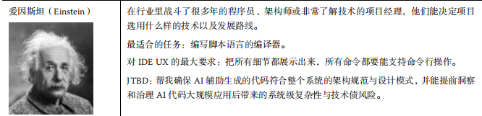
典型用户 – Visual Studio
老司机，架构师

Slide 17
产品不是为所有人服务的
实践：写下自己产品的典型用户
10 分钟
典型用户的模板可以包括：
1. 名字（越自然越好）
2. 年龄和收入（不同年龄和收入的用户有不同的需求）
3. 代表的用户在市场上的比例和重要性
比例大不等同于重要性高，如付费的用户比例 较少，但是影响大，所以更重要
4. 使用这个软件的典型场景
5. 使用本产品的环境（在办公室/ 家里/ 沙发/ 床上/ 公共汽车/ 地铁……）
6. 生活/ 工作情况
7. 知识层次和能力（教育程度，对电脑、互联网的熟悉程度）
8. 用户的动机、目的和困难（困难 = 需要解决的问题）
9. 用户的偏好

Slide 18
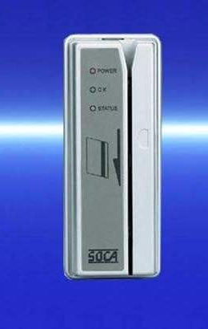
典型场景
现实生活中，一个银行从业者发的一条微博，他体会了“ATM无卡取现”功能的强大：
特意带上手机和令牌，不带银行卡，感受一下我行的无卡取现，结果连自助银行的门儿 都没进去，不刷卡怎么开门啊……
Notes:
如果这一重要功能的设计者在做需求分析的时候就模仿用户，设计场景，实地演一次戏，很快 就能发现戏演不下去了。

Slide 19
实践环节 – 典型场景下的典型用户 客户的任务和困难
典型用户
客户 | 问题
我们相信 [这种类型的客户] 为了实现 [某种目标] 需要完成 [这样的任务] | 他们在试图 [完成任务] 时碰到 [这样的问题], 因此受挫
小崔送给岳父一个 <健康电子手环>， 岳父第一次开机、用自己的手机完成设置和同步。
有什么困难？
在 手环/手机 之间切换多少次？
用多长时间才能完成？
张老师要给五年级的学生布置 100 道四则运算题目，她要怎么从自己的手机操作？
能改进 10X 么？
Notes:
填空

Slide 20
实践：找到最困难，最典型的场景
我们能提高 10X （用户满意度，效率）么？
提高 10X， 能促使用户给我们 5 星评价么？ 能提高用户使用率么？

Slide 21
探究客户到底需要什么？
[什么样的客户]
TA 在公司/家庭/学校/社区/…里面处于什么位置，负责什么?
TA 目前用什么样的办法/工具
[待完成的任务]
任务的频繁程度
任务的细节
[ 动机 ]
完成任务的动机是？完成之后是达到了什么状态
[ 问题 ]
最大的烦恼是什么？ 现在客户是怎么绕过这些问题的？
对于 [ 待完成的任务 ]， 如果你能改变一件事情，你想改变什么？

Slide 22
实践：继续描述典型场景
用快速原型工具或笔和纸
画出另一个典型场景，描述典型用户如何解决问题
原型设计的工具：
Axure， 墨刀，在 AI 时代，老工具已经被淘汰

Slide 23
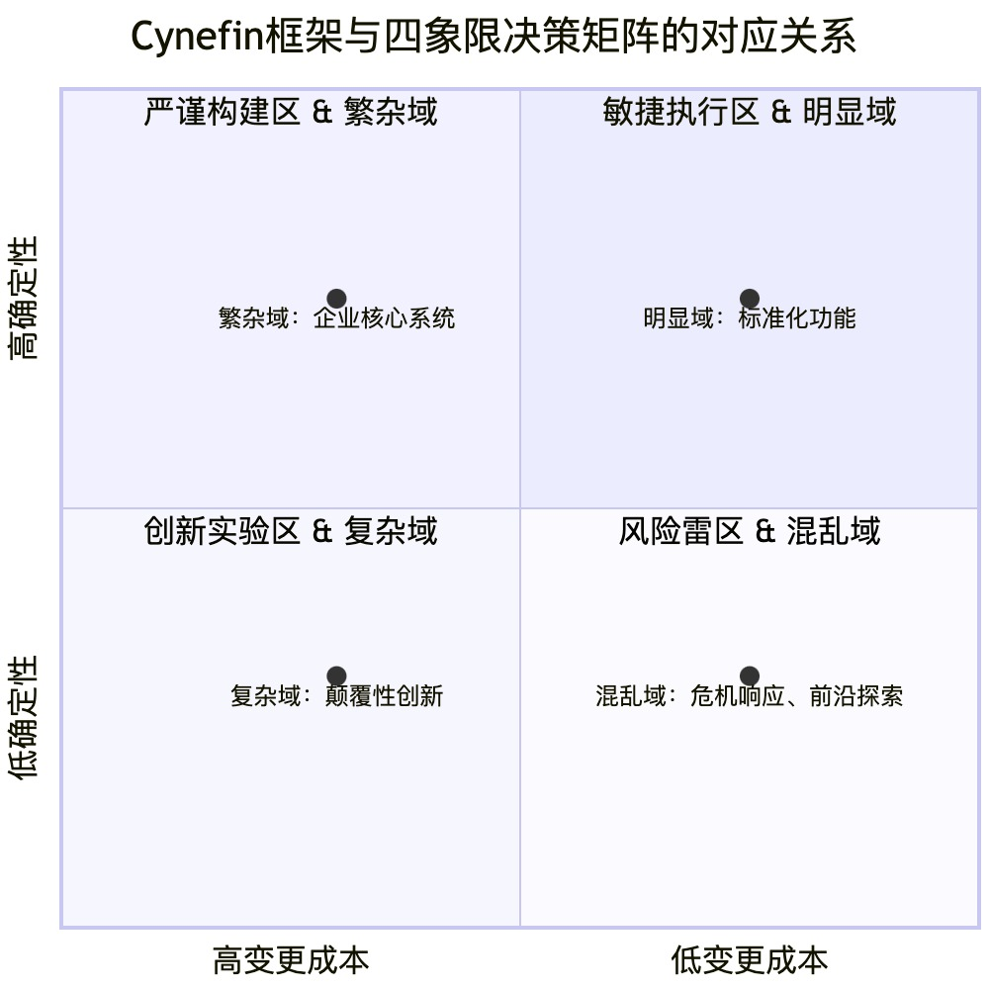
Cynefin框架与决策矩阵的对应关系
Cynefin框架和确定性-变更成本矩阵
不是让我们“斤斤计较分类”，
而是帮我们避免犯下代价高昂的认知错误，从而更有效地交付价值。

Slide 24

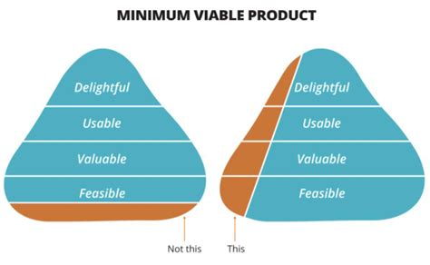
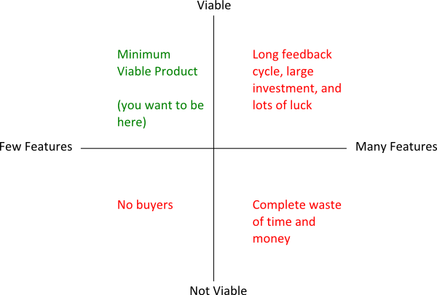
MVP vs. MBP
Minimum Viable Product (技术原型)
Maximum Beautiful Product （希望一炮而红的产品）
Notes:
https://speckyboy.com/successful-minimum-viable-products/

Slide 25
用户/需求分析
找到典型用户
我们就是研究院的研究员，难道我们还不是典型用户?
不是！
典型用户
Senior Researcher
Junior Researcher
Students
专业人士研究用户的UX/UI 需求
找到还没有被满足的需求

Slide 26
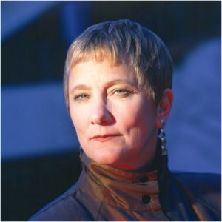
Anita – Senior Research
Researcher working in industrial lab (e.g. MSR researcher)
Education: PhD, Age: >=35, h-index > 20,
PAIN:
Hiring someone / check background
As Chair person, pick reviewers, PC member
Read/organize paper
Care about “my rank” in the domain, and correctness, completeness of my profile,
Care about rank of my dept.
Already know lots of people in such domain, knowing people is not top priority
Big influencer

Slide 27
John – Junior Researcher
College assistant professor
Handling both teaching and research
PAIN:
How to let more people know about my work?
Show my performance
Write paper with good reference
Generate a list of paper for a class / curriculum
organize, browse, and attending the right events.
Heavy user
Influencer – can influence students and peers.
Notes:
If I wan to see the trend and decide my next direction.

Slide 28
John - Scenarios
Show my network (co-author, co-occurrence) in my home page
Show my “publication list” via simple javascript.
Track Conferences
See the timeline of a field (e.g. the up and down in papers about “Machine Learning”).
User contribution:
John finds that Libra doesn’t cover all of his papers, he provides a URL via libra UI, and a couple of days, he is happy to find out that libra covers his new papers.

Slide 29
Brian – student
PhD student major in CS
Frequently go online looking for paper for his/her own research,
PAIN?
Working on his 1st or 2nd important paper
Need a comprehensive source of papers for homework and project
Check out researcher profiles (to help apply for advanced study)
Keep track of new papers
Job hunting
English as 2nd language
500K IT students in China

Slide 30
Brian - Scenarios
Notify me when something happens
Get all papers in one field
Related papers
Check the importance of journals, conferences
Name disambiguation
Find Michael Cohen
Find out the “family tree” of a scholar, to understand his/her impact

Slide 31
用例 Use Case
和敏捷/MSF Persona/Scenario 类似
局限性
故事/任务/场景非常适合交互式的系统。但是对其他类型的需求（算法，效率，安全性，系统）不适用。
故事的粒度没有标准
如何把UI 的细节嵌入每个故事中？
User Case → User Case Storyboard

Slide 32
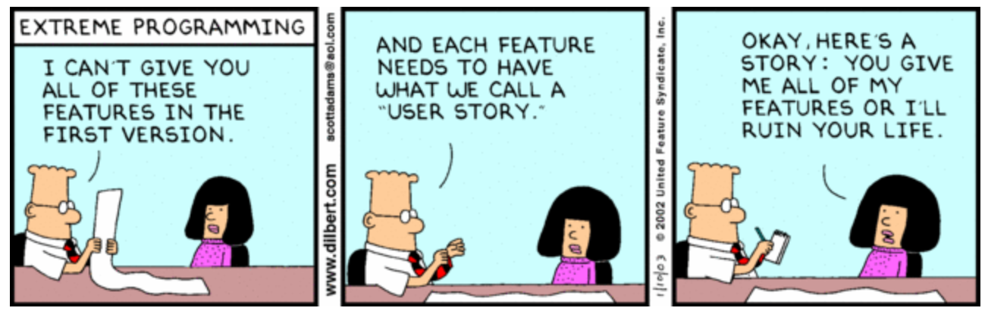
Scenario = User Story

Slide 33
规格说明书

Slide 34
Spec
Spec = Specification /规格说明书
Functional Spec
Tell people about a feature/function of a product, From user’s perspective
It doesn't care how the thing is implemented. It talks about features. It specifies screens, menus, dialogs, and so on.
Technical Spec (aka design doc)
Tell the software team member or other partners how the function is implemented
data structures, relational database models, choice of programming languages and tools, algorithms, etc.

Slide 35
Spec Exercise – round 1
How long does it take for you to “tie your shoe laces”?
Write a spec so that an alien (外星人) can understand and execute how to “tie your shoe laces” (系鞋带)
Each pair come up with one spec (10 minutes)
Compare with your neighboring pair, pick the winner
Tell us the reason for win/lose
Good points of the winner
Weak areas for the loser

Slide 36
Spec Exercise – Round 2
Definition:
what is “shoe”, “shoe laces”, “tied shoe laces”, and “untied shoe laces”
Benefit of this feature “tie your shoe laces”
The goal of the feature?
What does “success” look like?
Unambiguous steps to achieve from “untied” to “tied”
Written in English, Graph (UML) is optional.
2 pairs work together for a new spec
10 minutes to improve the spec

Slide 37
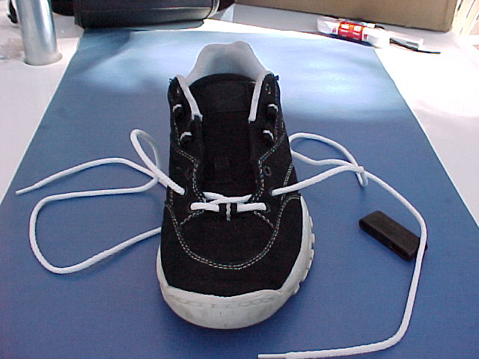
Assumptions
start from empty eyelets?
Or assume user can do that already?

Slide 38
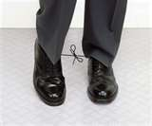
If user follows your spec…
Notes:
What’s the end-result?

Slide 39
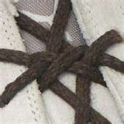
Does it have to be so complicated?

Slide 40
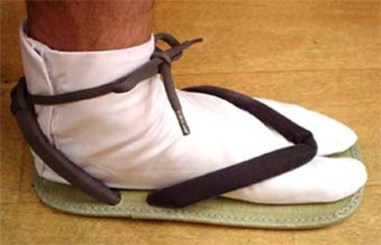
Does your spec cover this?

Slide 41
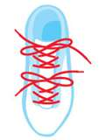
Is this ok?

Slide 42
Final round
What does “success” look like?
Can you use unambiguous words to describe it?
Final Two candidates competing for the winner

Slide 43
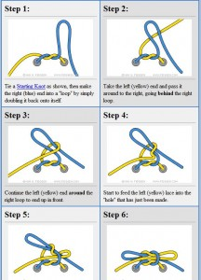
Spec as clear as this?

Slide 44
Functional Spec
Title
Status
Incomplete / complete
Contact person (1 person)
Responsibility and accountability, still based on team input
Overview
Scenarios
How people benefit from the feature you describe
Go as detail as you can
Non-goals
Open issues

Slide 45
设计方法论介绍
FDD - Feature Driven Development (功能驱动的设计）

Slide 46
功能驱动的开发 FDD
构造总体模型 Develop Overall Model
The project starts with a high-level walkthrough of the scope of the system and its context.
构造功能列表 Build Feature List
identify a list of features. extract business activities, the steps within each business activity form the categorized feature list.
Features in this respect are small pieces of client-valued functions expressed in the form <action> <result> <object>:
Calculate the total of a sale
Validate the password of a user
Share comments to other users
制定开发计划 Plan By Feature
Produce the development plan – who is going to do it, when?

Slide 47
Design & Build
功能设计阶段 Design By Feature
团队成员在主程序员的带领下，分析一组相关的实体及其功能，通过时序 图（Sequence Diagram）和其他工具，展示各个实体和函数如何动态地结合起来实现一 个功能。.
实现具体功能 Build By Feature
具体的团队成员要实现类/ 函数，进行相关的单元测试，并在代码复审之后，把代码集成 到产品构建当中。

Slide 48
FDD – Best Practices
建模 - Domain Object Modeling.
领域实体模型 Domain Object Modeling 现实世界是怎样的，有什么实体，他们的静态和动态关系是怎样的？在这个模型上面，我们才能系统地开发和增加功能
功能驱动地开发 - Developing by Feature.
如果功能太复杂，我们就把它分解，直到能在较短时间完成（两周）。
模块的负责人 - Individual Class (Code) Ownership.
每个模块都有单一的负责人，此人负责这个模块（类）的语义完整性和一致性。（不能因为实现的方便，胡乱添加功能，导致一个模块的内在逻辑受到破坏）
功能小组 - Feature Teams.
小团队，动态组合，平等讨论、合作完成功能。

Slide 49
FDD – Best Practices
复审 Inspections.
设计，代码复审 争取早日发现问题
每日构建 Regular Builds.
保证最新的版本总是可用的，早日发现系统集成方面的问题.
经常报告进度和测试结果 Visibility of progress and results.
这样相关角色能知道团队的进度，问题，并做好应对，降低风险

Slide 50
讨论
http://www.cnblogs.com/xinz/p/3855296.html

